Slide 1
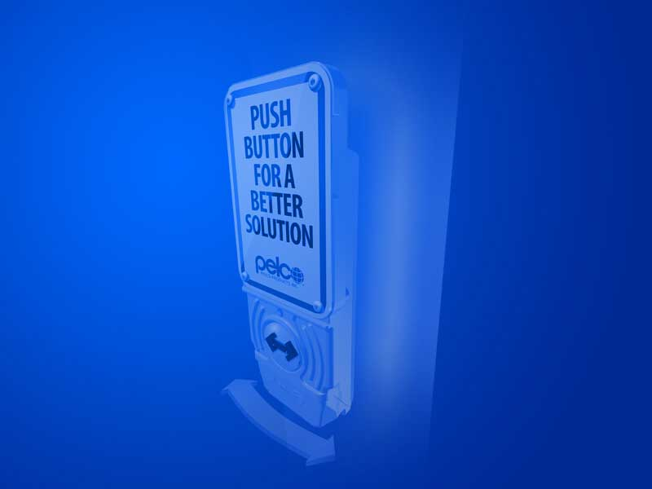
Main Menu
Product Options
Composer
Product Delivery
Pelco Service
Features
CIU-C

Slide 2
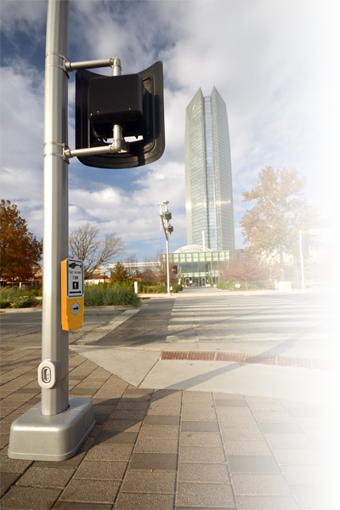
Product Options
And Configurations

Slide 3
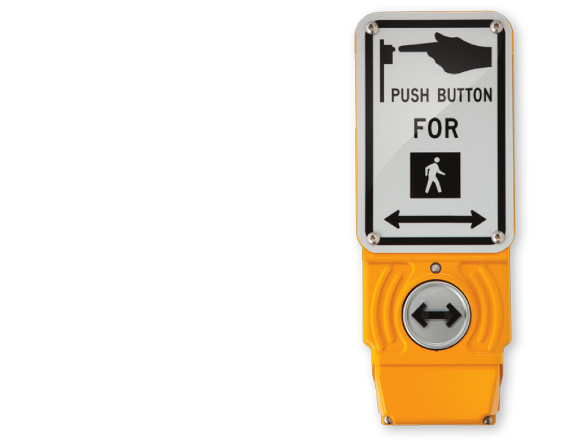
Product Options
SE-2900
MUT0CD Standard
SE-2901
Customized Product

Slide 4
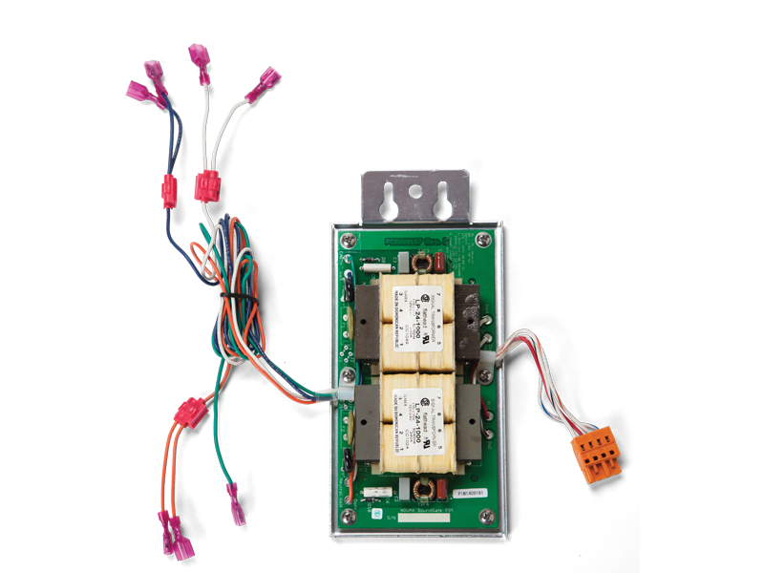
Product Options
Minimum Requirement for each button installation
Power Interface Module (PIM)
Included with each button

Slide 5
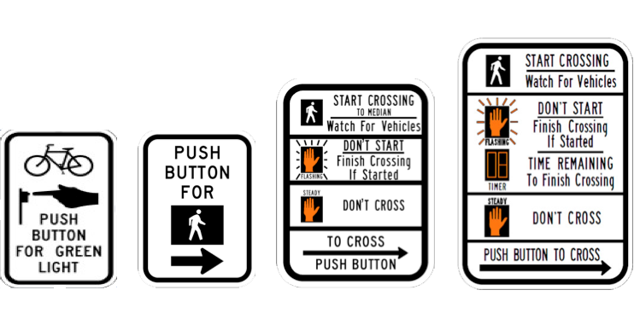

Product Options
Product Options:
    Button color
    Sign
    Double Arrow
5 x 7.75
9 x 12
9 x 15

Slide 6
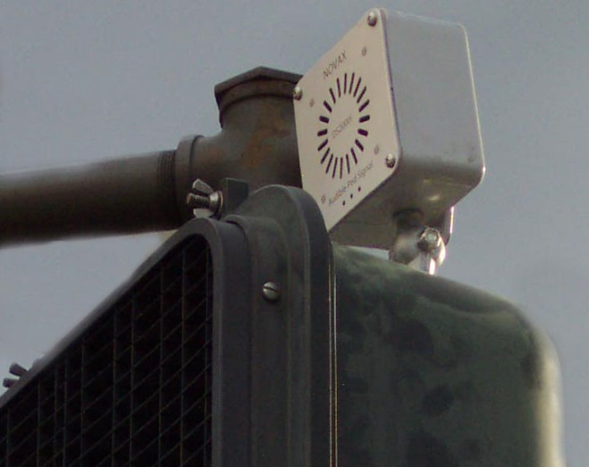
Product Options
Overhead Speaker for crossing guidance
  Accessories
    External Speaker
    Overhead Speaker
      Existing speaker can be
    used with Pelco IntelliCross,
    thus protecting your investment

Slide 7
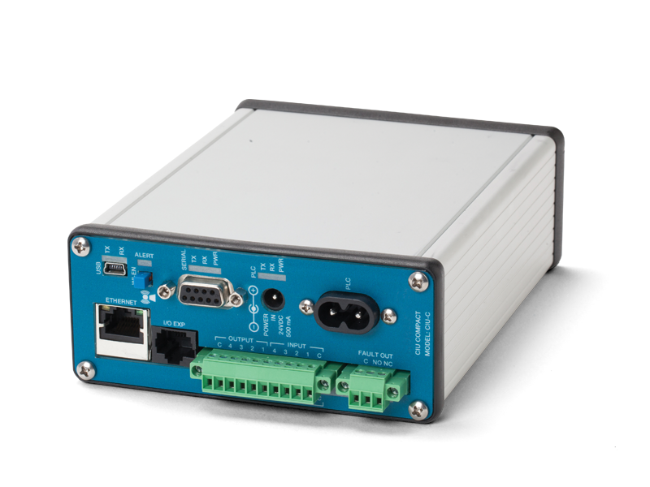
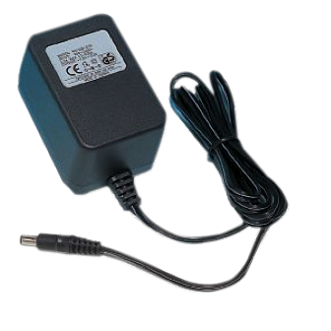
Product Options
Accessories
    CIU-C (Compact)
    CIU-C Power Adaptor
50% smaller than other CIU’s
DIN Rail mount option
Most common options
CIU-C
4 DC/AC inputs
4 Outputs
Ethernet
USB
RTC
I/O Expansion Port
Wi-Fi Option
CIU-C Power Adaptor
24Vdc, 0.5A
Only needed where existing 24Vdc not available

Slide 8
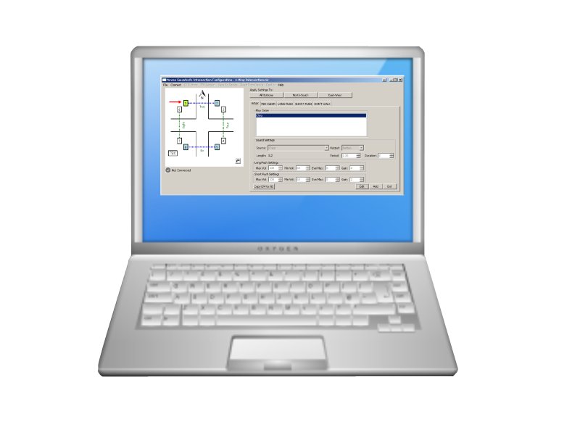
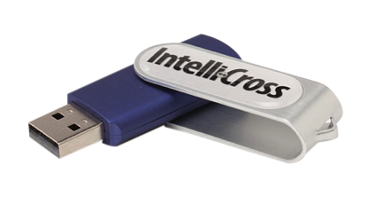
Product Accessories (required)
Programmer Toolkit
USB Stick (Pre-installed with Symphony Software
USB Cable (3ft)
Accessories
    Programmer
    Programming Software (Symphony)
  Toolkit
If multiple contractors provide
service, you can leave a USB stick and Cable in the cabinet
FIRST TIME BUYERS
Require at least ONE of the above
Clients may choose to use their own laptop or tablet or purchase one.
Programmer
MS Windows™ 8 OS
Wi-Fi
Pre-installed APS Button Application

Slide 9
Composer
Intersection Configurator

Slide 10
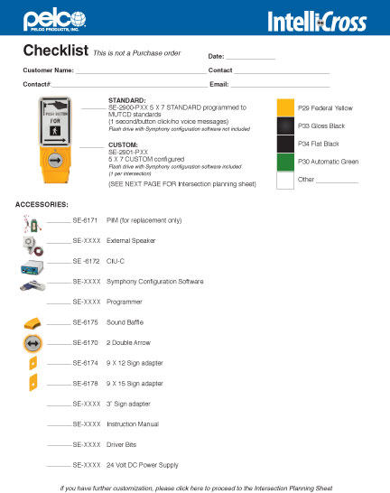
Composer
Checklist
    Tool to help determine hardware and configuration needs

Slide 11
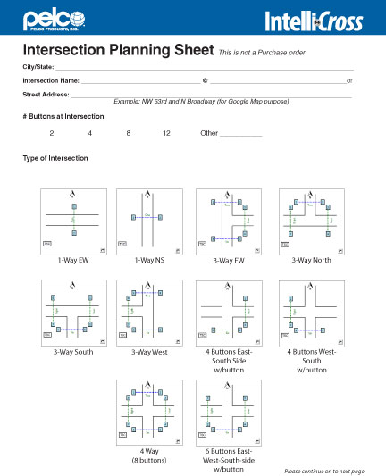
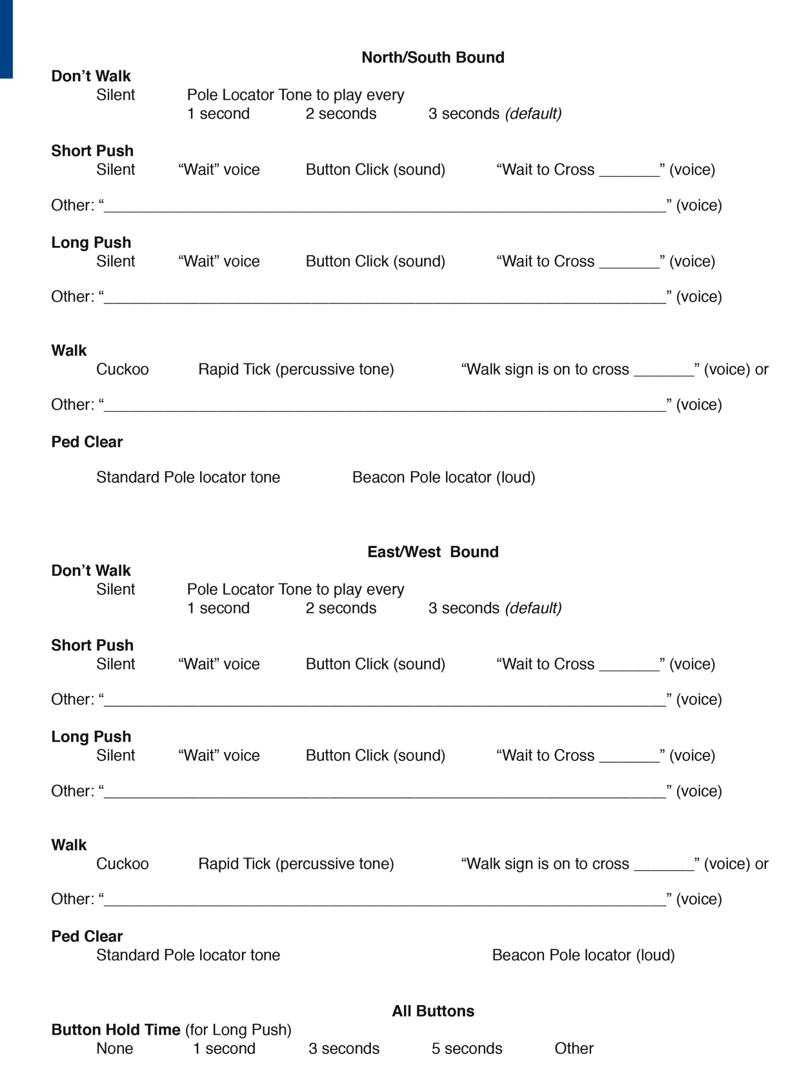
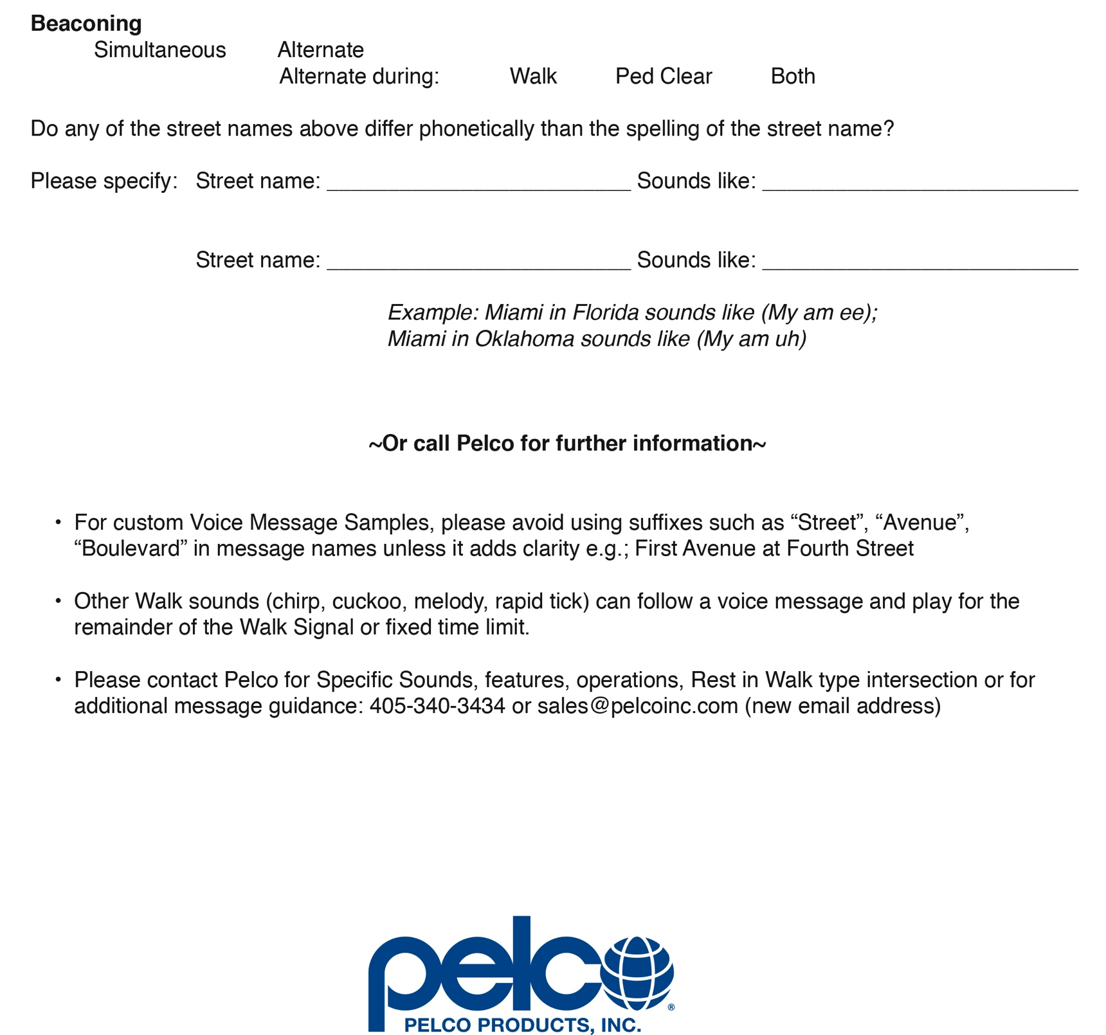
Composer
Intersection Planning Sheets
    • Tool to custom
    configure an
    intersection

Slide 12
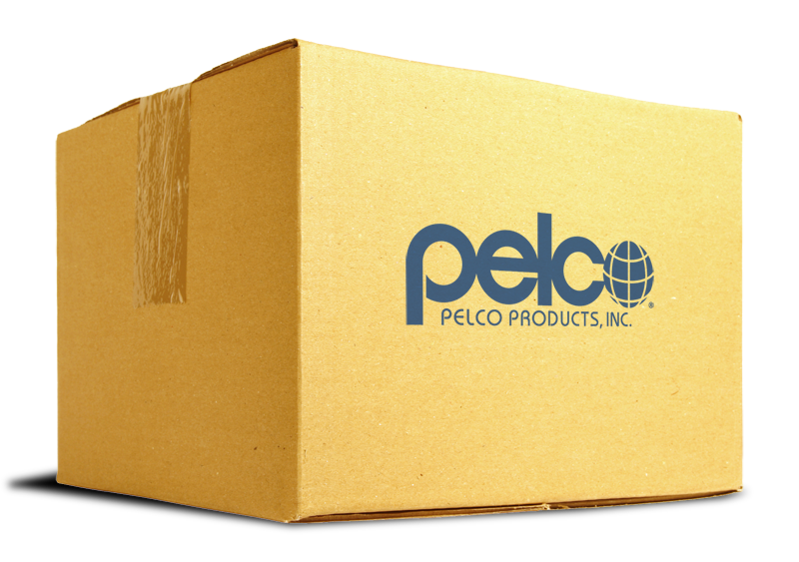
Product Delivery
Getting it all together

Slide 13
Product Delivery
Each product will be tested before shipping
Packing list provided
Quick Installation Guide provided for each intersection
Intersection specific labeling

Slide 14

Pelco
Service

Slide 15
Pelco Service
Technical Support
    Help with terminal connections
    Troubleshooting a configuration
    Custom setup needs
    Troubleshooting wiring issues
    Software setup support
    Arrange RMA for goods return/warranty
    Availability
    Technical Support Available 7a – 5p M - F
    405.340.3434
    IntelliCross@pelcoinc.com

Slide 16

Standards (Caltrans)
IntelliCross APS meets Caltrans APS Guidance.
IntelliCross is the only "intelligent button system"
that is compliant with the Caltrans APS Guidance (buttons communicate using existing intersection wiring).
“Participated in the Caltrans
APS Guidance development.”
A leading agency of standards and mobility in CA and recognized North America-wide

Slide 17
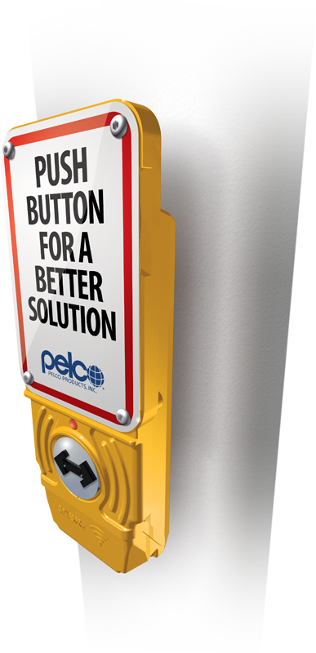
IntelliCross Features

Slide 18
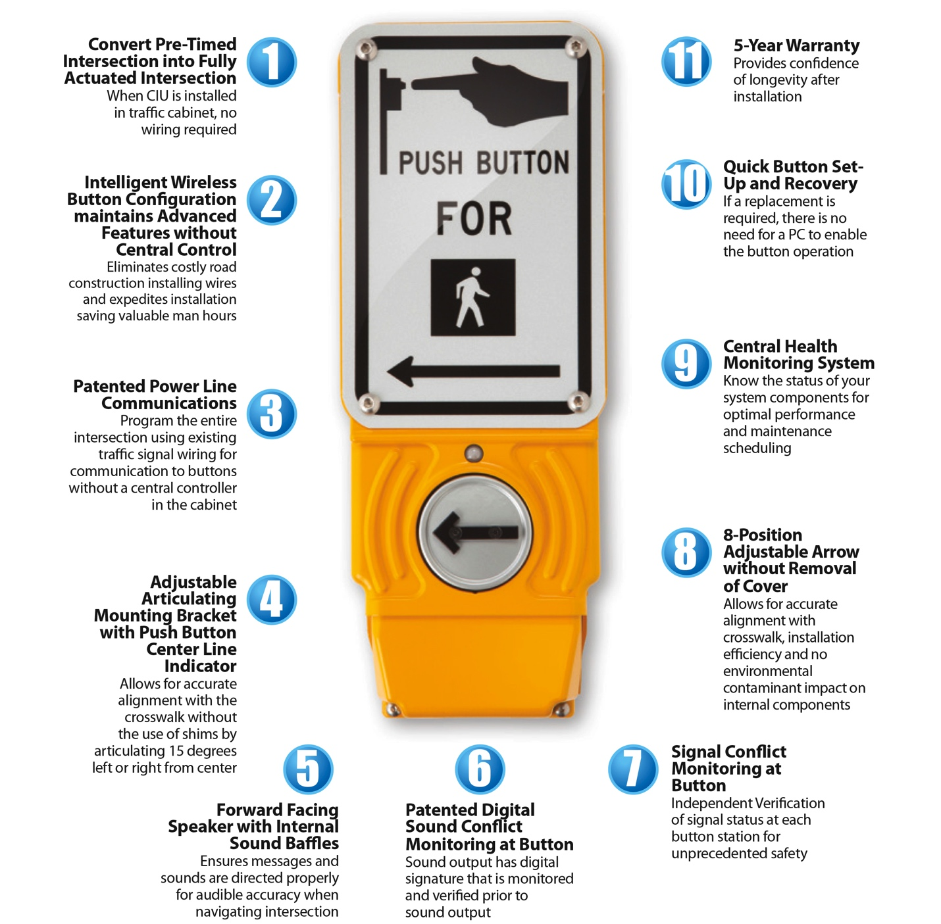
IntelliCross Features

Slide 19
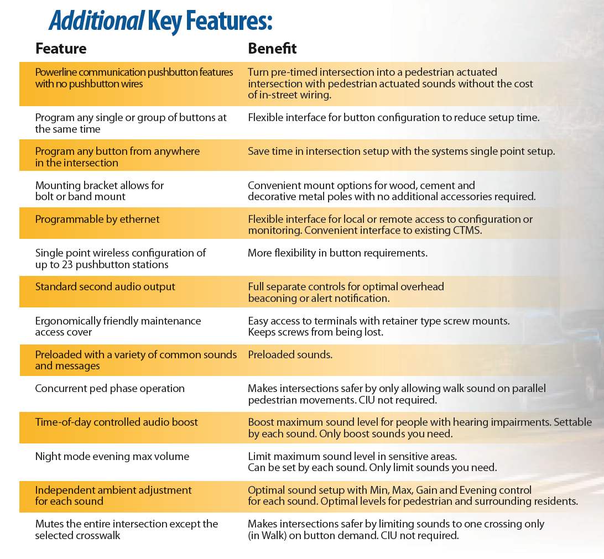
IntelliCross Features

Slide 20
IntelliCross Features
“IntelliCross is cost and functionally competitive
with other providers of 2-wire APS systems”
Push Button
  Intelligent Button
  Raised Vibra-Tactile Arrow
  Latching LED Indicator
  Connects to standard
  TSC push button wiring
  (fault tolerant)
  High Impact button
  Cane friendly
  Tactile Bump

Slide 21
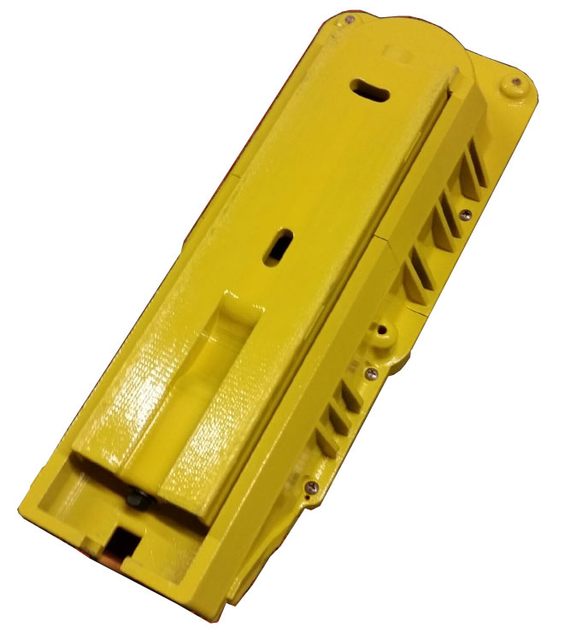
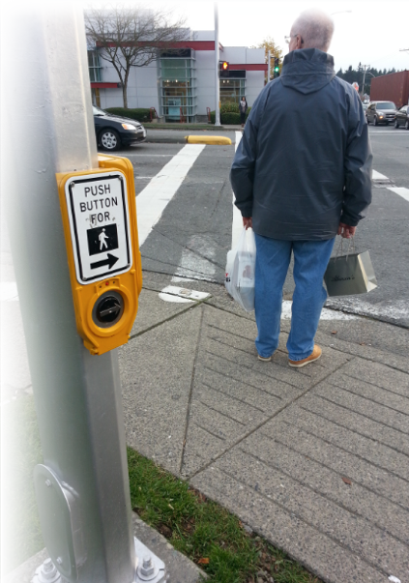
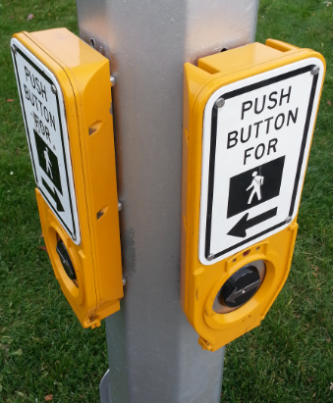
IntelliCross Features
Push Button
  Articulated bracket +/- 15º
  Easy 2-piece installation and maintenance
  Easily aligns to crosswalk making crosswalks safer
The competition points pedestrians in the wrong direction

Slide 22
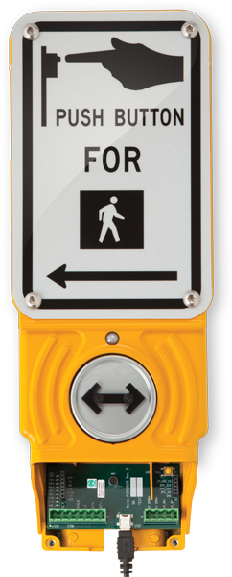
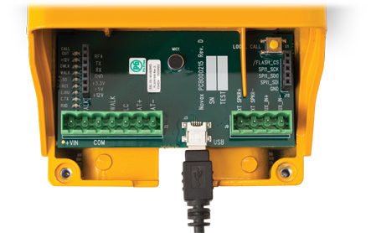
IntelliCross Features
Push Button
  Easy access removable cover
  Quick connect plugs, USB port, LED status indicators
  Future expansion port for Wi-Fi
LED
Expansion Port
Quick Connect
USB

Slide 23

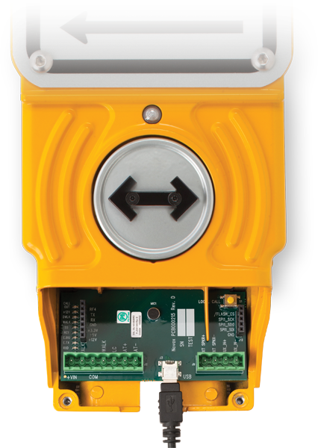

IntelliCross Features
Push Button
  Vibrating arrow rotatable WITHOUT removing / opening button cover
  Preserves integrity of the button environment and longevity of the button by not exposing the internal components to the environmental contaminants
  Shorter installation time

Slide 24
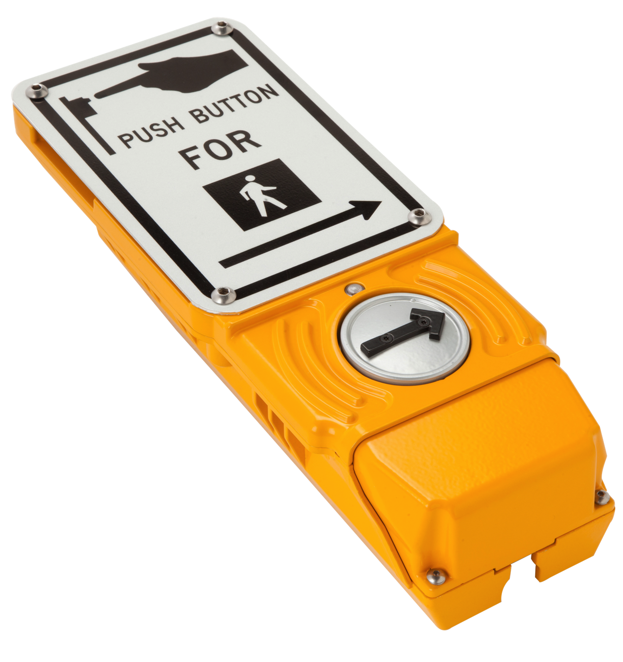
IntelliCross Features
Easy Add Sound Baffles for Better Sound Control

Slide 25


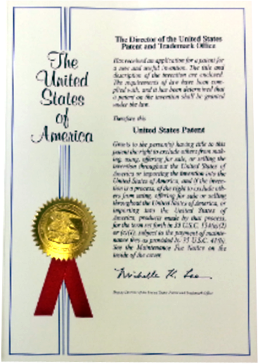
IntelliCross Features
Digital Sound Conflict Monitoring
(US & Canada Patents)
  Self Check to ensure ultimate safety
  Sound output has digital signature that is monitored and verified prior to sound output (NOT available in ANY other APS system)
25

Slide 26

IntelliCross Features
Power Line Communications
(US & Canada Patents)
  Uses existing traffic signal wiring for communication to buttons
  No extra wiring required from TSC
  No central controller required
  Distributed intelligence
  No Single Point of Failure
  Unique features
  to IntelliCross

Slide 27
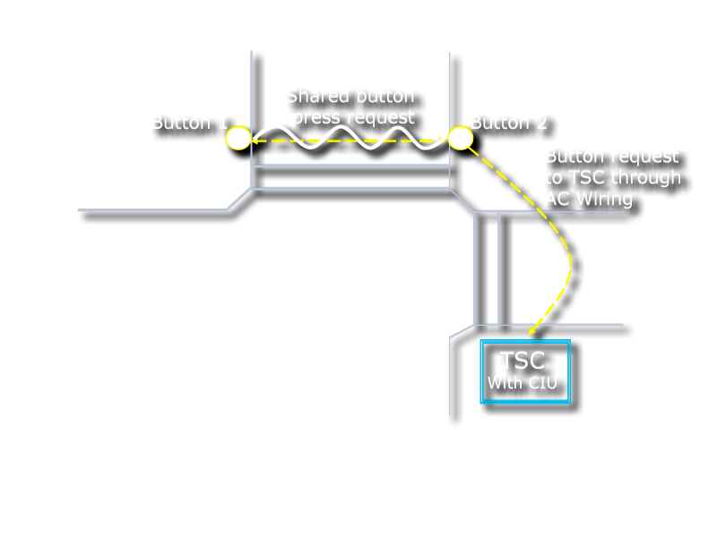
IntelliCross Features
“Unique & Specable Pre-timed Intersection Solution”
Wireless Button Solution
Features
Intelligent button communications
Allows buttons to be “paired”
similar to Bluetooth™
With a CIU, buttons will behave as if there were button wires at the intersection
With a CIU you have a complete wireless PB solution Converts a Pre-timed intersection to Fully Actuated.
Where there are no existing button wires available
No road construction work required
Saves ~$10K per crossing

Slide 28
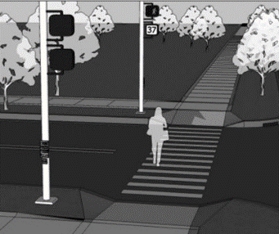
IntelliCross Features
Synchronized Sound Operation
  Extended button push can:
    Turn on, boost volumes on far side buttons,
    Mute all sounds except those on the activated crosswalk
  Provide concurrent Ped Phase sounds
  No central controller required

Slide 29
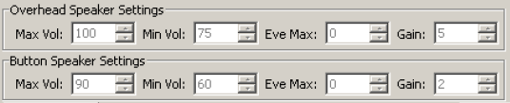
IntelliCross Features
Independent volume controls
    Independent volume controls for
    EVERY sound
    All sound levels in decibels for standardization
    Uses MUTCD standards for dBs
    No pre-set percentages
    Greater flexibility for volume control
    Greater sound accuracy, with + or – 5dB

Slide 30
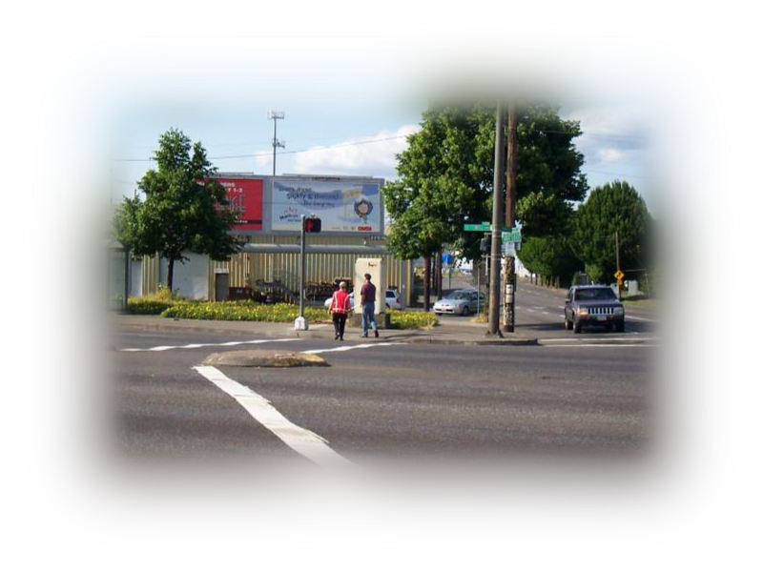
IntelliCross Features
Second Audio Output
  Standard feature on all APS units
    Optional on competition
  Allow connection of a remote (overhead)
  speaker to the button station that can
  provide guidance to pedestrians while
  traversing the crossing area
Uses Beaconing Technology to Assist Pedestrians
Pedestrian Path
i.e.; course correction
with each Tick or “Chirp”
APS

Slide 31

IntelliCross Features
Up to 23 buttons can be connected
  Standard feature on all APS units
  Provides seamless integration at diamond interchanges or close intersections
    Largest Connection Capacity in the Industry; Competition only connect up to 16

Slide 32

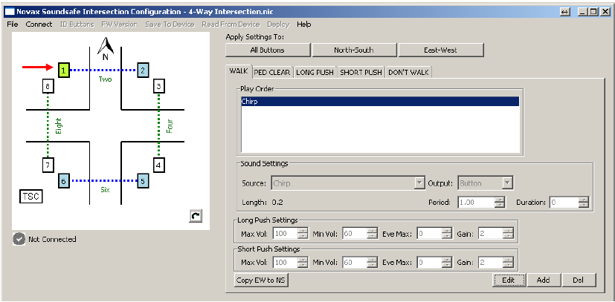
IntelliCross Features
Program from anywhere in the intersection
  Standard feature on all APS units
  All buttons can be programmed from anywhere in the intersection EVEN WITHOUT A CENTRAL CONTROLLER!
  Competition requires a central controller unit for remote programming otherwise each button must be programmed individually

Slide 33

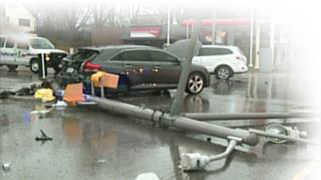
IntelliCross Features
Quick button setup and recovery
  Standard feature on all APS units
  Buttons can be pre-configured at Manufacturer
  or by the distributor
  No message wake up
  Buttons arrive with no sound but basic button operation waiting for intersection commissioning
  Customer or Contactor can “enable” the button operation with a “Button Handshake”
  (special button press sequence).
  No PC setup required.
  Standard feature on all APS units
  If a button is damaged (e.g. knockdown accident) a button can easily replaced with a stock button.
  Client or Contractor can configure the
  button from the existing buttons
  through a “Button Handshake” (special button
  press sequence).
  No PC setup required.

Slide 34
IntelliCross Features
CIU-C
  CIU Hardware Support:
  Standard Interface to NEMA TS1/2 & Type 170, 2070, Type F
General-purpose inputs and outputs available on the CIU can be configured for a variety of different applications.
System Configuration Device offers centralized:
      Button configuration
      Firmware Update
      Custom Sound Upload
      Ethernet remote to central
      Button health monitoring

Slide 35
IntelliCross Features
CIU-C
Easy-to-add monitoring
TSC or Central
Time of Day control
Self contained Intelligence
(at the pole)
Offers the most competitive IP package upgrade for a fully
IP addressable system and is the ONLY product that will maintain compliance with Caltrans APS Guidance where a control
or monitoring unit is required in the traffic cabinet.

Slide 36
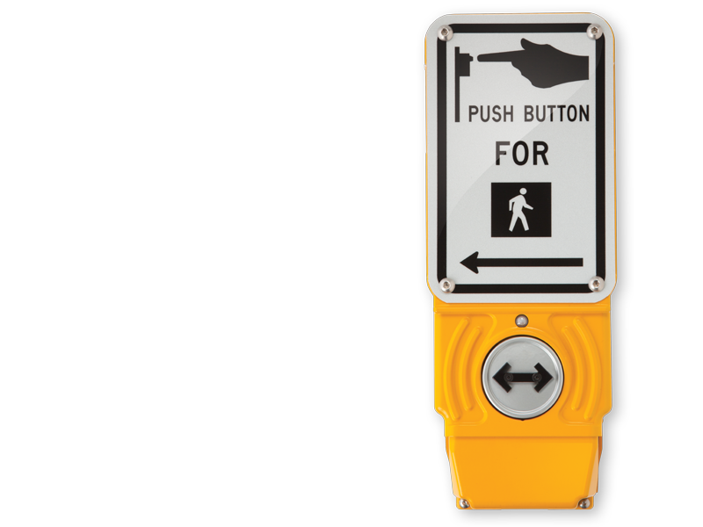
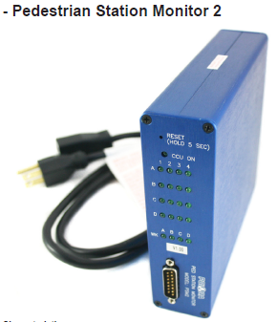
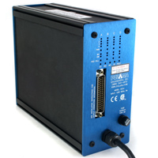
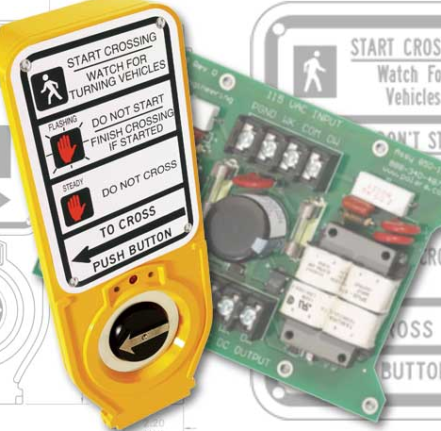
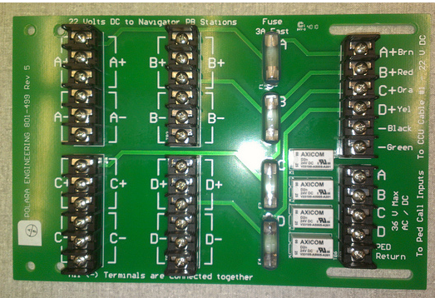
System Comparison
(central communication)
IntelliCross
The IntelliCross system is the ONLY system that is easily field upgradable to central control
with just the addition of a CIU
to cabinet power
Navigator™
(2-wire)
In-cabinet
On-street
On-street
In-cabinet

Slide 37
System Comparison (4-wire)
IntelliCross
Navigator™

Slide 38
Audible Countdown
Audible Countdown function at the Pedestrian pushbutton stations
  Not included in any North American standards
  Not recommended by industry leading professionals
  Maybe included at a later date if approved by Government bodies or recognized organizations involved in pedestrian safety

Slide 39
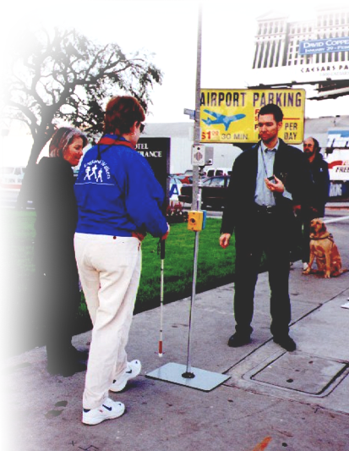
Audible Countdown
Countdown Messages
“In the interest of safety, an
ambiguous display cannot be
recommended.
The countdown information in an audible format has the potential to mask auditory information from cars that may be more critical.
After starting a crossing, the blind pedestrian has little other choice but to complete the crossing, even if the pedestrian phase has ended.”⁽¹⁾
1- Accessible Pedestrian Signals and Countdown Pedestrian Signals: Providing Clearance Interval Information –
By Billie Louise Bentzen, Janet Barlow and Lukas Franck

Slide 40
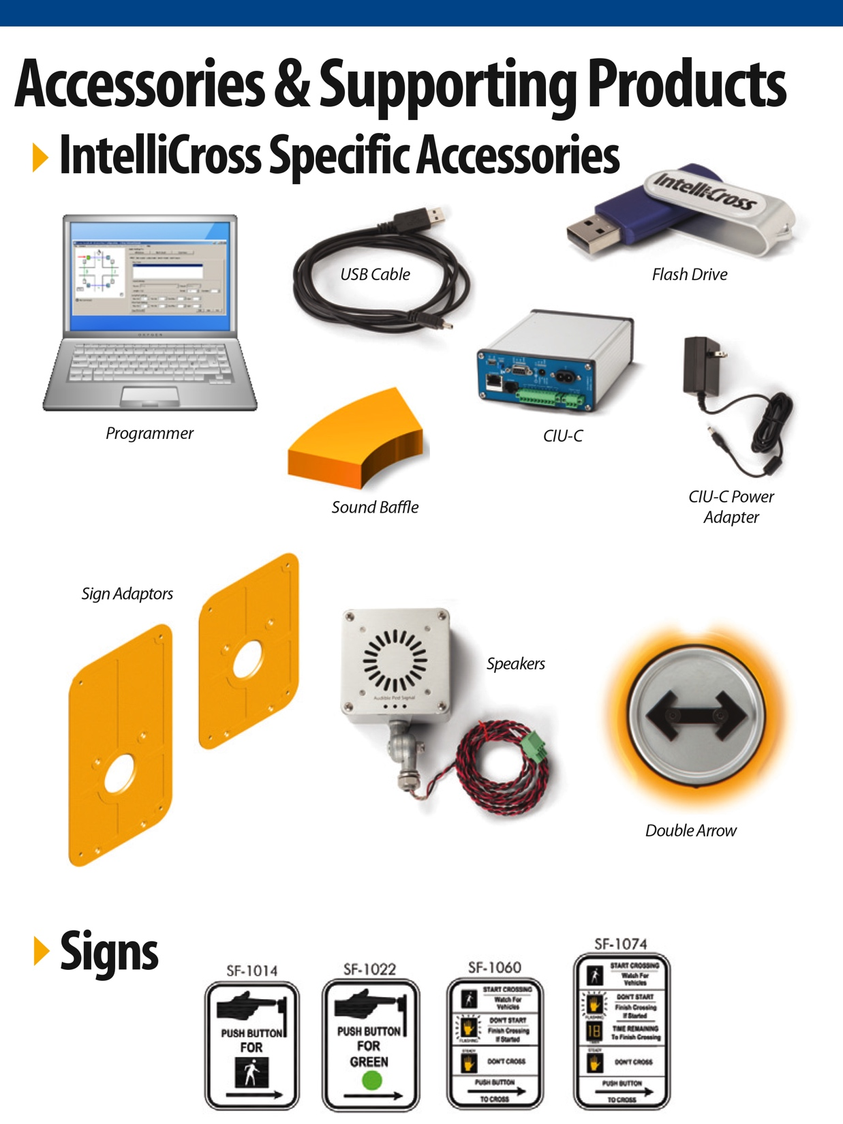
Accessories & Support Products

Slide 41
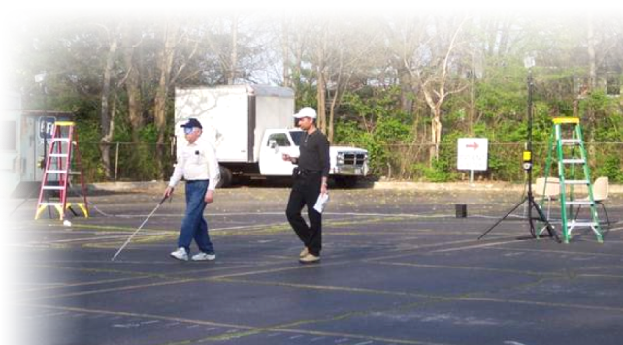
Research & Contributions
Street-level testing and development with local traffic agencies and advocacy groups.
On-going commitment of resources in assistance of research endeavors of:
  $ 4 million US APS research study
    (Novax appointed as technology supplier and advisor)
  CNIB , ACB, NFB
  Transportation Research Board (TRB)
  Toronto Transportation
  Audible Pedestrian Signals
  Advisory Group

Slide 42
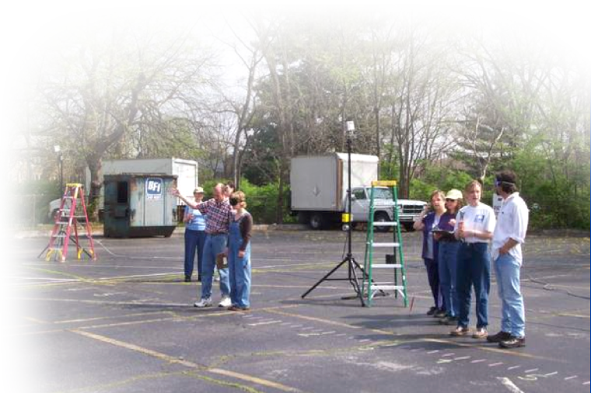
Research & Contributions
On-going commitment of resources in assistance of research endeavors of:
  Accessible Design for the Blind
  American Council for the Blind
  Institute Nazareth et Louis-Braille
  ITE MUTCD Guidance (contributed significantly in efforts and funding in construction of guidelines
  ISO Draft Committee specification
  Adherence and Promotion
  International Mobility Conference
  (IMC) Support and Research

Slide 43
For More Information
405.340.3434
PelcoIntelliCross.com
Intellicross@pelcoinc.com

