Slide 1


PRESENTS

Slide 2
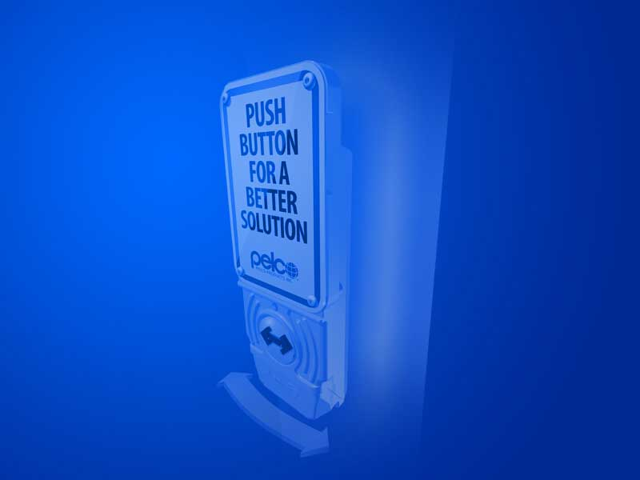
APS 101
APS 101
For the most current MUTCD standards and information, click here.

Slide 3

What is an APS?
  As per MUTCD
  (Section 4A.02),
  Accessible Pedestrian Signals (aka. APS) is a device that communicates information pedestrian timing in non-visual format such as audible tones, verbal messages, and/or
  vibrating surfaces.

Slide 4
Benefits & Purpose of an APS?
  Sighted pedestrians have been found to start crossing more quickly and more uniformly where an APS is provided. Research found more consistent start with 20% reduction in starting delay when there was an audible walk indication.

Slide 5
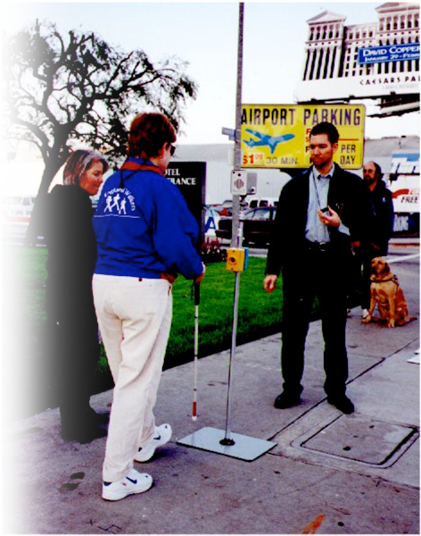
Benefits & Purpose of an APS?
  Blind pedestrians make more accurate judgments of onset of the walk interval. There is a reduction in the number of crossings begun during DON’T WALK and reduced delay in beginning to cross when the signal changed, resulting in significantly more crossings completed before
  the signal changed.

Slide 6
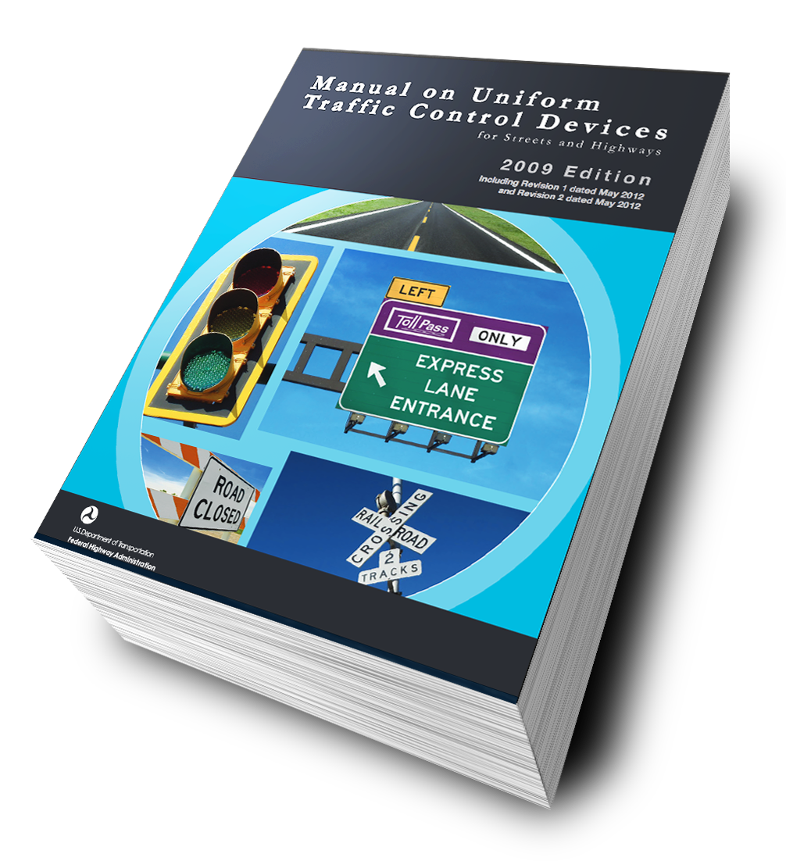
Laws, Guidelines and Governing Agencies - MUTCD
  The Manual on Uniform Traffic Control Devices, or MUTCD
  defines the standards used by road managers nationwide to install and maintain traffic control devices on all public streets, highways, bikeways, and private roads open to public travel. The MUTCD is published by the Federal Highway Administration (FHWA) under 23 Code of Federal Regulations (CFR), Part 655, Subpart F.

Slide 7
Laws, Guidelines and Governing Agencies - MUTCD
  The Manual on Uniform Traffic Control Devices (MUTCD) defines an accessible pedestrian signal as “a device that communicates information about pedestrian signal timing in non-visual format such as audible tones, speech messages, and/or vibrating surfaces”.
  PROWAG

Slide 8

Laws, Guidelines and Governing Agencies - PROWAG
  The Access Board charter the Public Rights-of-Way Access Advisory Committee (PROWAAC) in 1999 to develop recommendations for public rights-of-way.

Slide 9
Laws, Guidelines and Governing Agencies - PROWAG
  The committee was made up of individuals with disabilities, advocates for individuals with disabilities, traffic engineers, planners, public works officials representing cities, state DOTs and professional organizations.

Slide 10
Laws, Guidelines and Governing Agencies - PROWAG
  The committee published its recommendations in a report completed in 2001, “Building a True Community.”
  The Access Board took PROWAAC recommendations and developed Draft Public Rights-of-Way Accessibility Guidelines (Draft PROWAG)

Slide 11
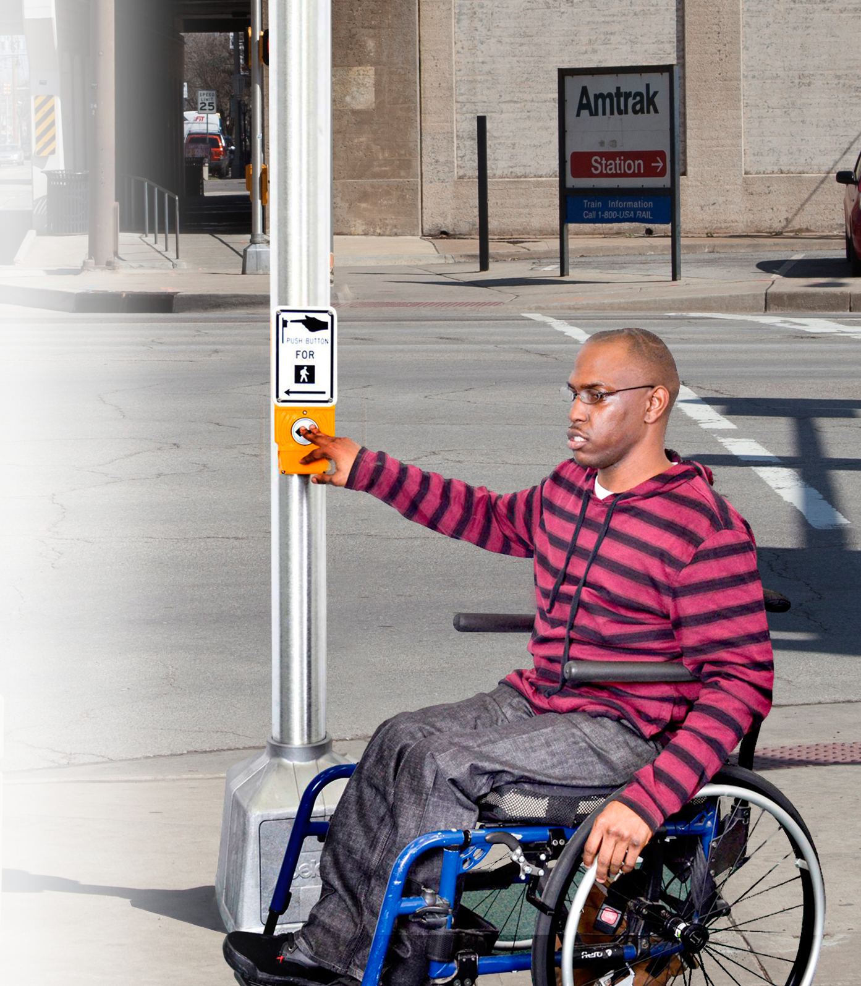
Laws, Guidelines and Governing Agencies - ADA
  Americans with Disabilities Act of 1990 (ADA) states that “each facility…constructed by, on behalf of, or for the use of a public entity shall be designed and constructed in such manner that the facility…is readily accessible to and usable by individuals with disabilities…”

Slide 12
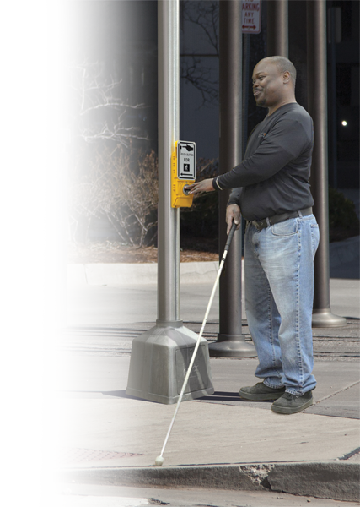
Laws, Guidelines and Governing Agencies - FHWA
  Federal Highway Administration (FHWA) requires sidewalks and crossings to be “designed, constructed, operated and maintained so that all pedestrians, including people with disabilities, can travel safely and independently.”

Slide 13
Functions of an APS
  Provides information to pedestrians about:
  Existence of and location of the pushbutton
  Beginning of the WAL interval
  Direction of the crosswalk and location of the destination curb

Slide 14
Functions of an APS
  Provides information to pedestrians about:
  Intersection street names in Braille, raised print, or through speech messages
  Intersection signalization with a speech message

Slide 15
Functions of an APS
  Provides information to pedestrians about:
  Intersection geometry through tactile maps and diagrams, or through speech messages

Slide 16
Benefits of an APS
  More accurate judgment of the onset of the WALK interval
  Reduction in crossings begun during DON’T WALK
  Reduced delay
  Significantly more crossings completed before the signal changed

Slide 17

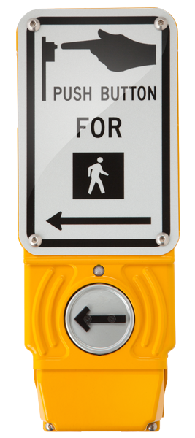

Types of APS in the U.S.
  Pushbutton - Integrated
  Common in Europe and Australia and rapidly becoming common in the U.S.
  Speaker and vibrating surface located at the pushbutton
  A regularly repeating quiet locator tone provides information about the presence of the pushbutton and its location during flashing and steady DON’T WALK intervals

Slide 18
Types of APS in the U.S.
  Pushbutton - Integrated
  Pushbutton locator tone and WALK indication volumes respond to ambient sound
  Volume is typically adjusted to be heard only at the beginning or crosswalk
  May provide other information about the name of streets or the geometry of the intersection, or signalization

Slide 20
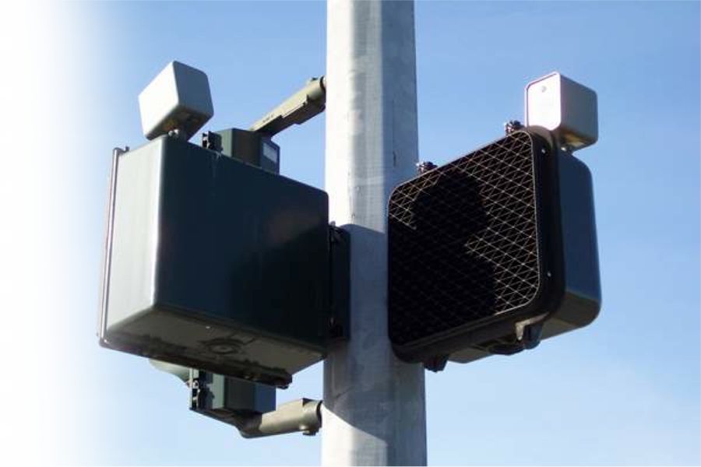
Types of APS in the U.S.
  Pedhead-Mounted
  Most common type installed between 1960 and 2000 in the U.S.
  Speaker mounted on top of the pedestrian signal head (aka pedhead)
  Bell, buzzer, cuckoo, chirp, tone, or verbal message during the WALK interval only

Slide 21
Types of APS in the U.S.
  Pedhead-Mounted
  Usually intended to be heard across the street and act as a beacon, thus are relatively loud

Slide 22
Types of APS in the U.S.
  Receiver-Based
  Message transmitted by infrared or LED technology from the pedestrian signal to a personal receiver held by the individual
  Blind pedestrians must have and use the appropriate receiver for the technology installed
  May provide other information about the name of streets, geometry of the intersection, direction of travel, and address information

Slide 23
Types of APS in the U.S.
  Vibrotactile-Only
  Arrow on the pushbutton housing or the pushbutton itself vibrates during the WALK interval
  Vibrotactile-only devices are
  no longer available in the U.S.,
  and do not conform to
  Draft PROWAG

Slide 24
Signalization & Timing Plans
  Intersections are generally designed to provide optimal vehicle traffic flow. Timing plans may be of two general types:
  Fixed Time (or Pretimed)
  Pretimed intersections operate in predetermined and predictable fashion
  Actuated
  Actuated signals change the length and/or order of the phases in response to variations in vehicle or pedestrian traffic

Slide 25
Signalization & Timing Plans
  A signal at a given intersection may be designed to change from actuated to pretimed to flashing mode depending upon:
  Time of day
  (peak periods vs. non-peak periods)
  Day of week
  Malfunctions due to power outages

Slide 26
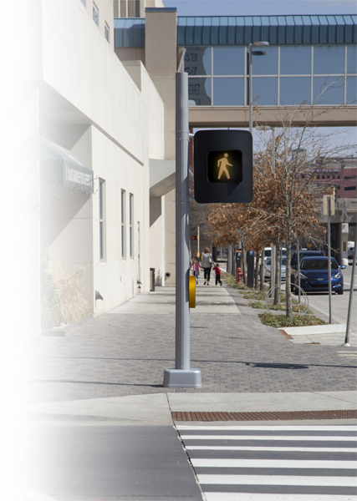
Pedestrian Signals & Timing
  Pedestrian signal heads
  (aka pedheads) are installed at some intersections to instruct pedestrians when it is lawful to cross.

Slide 27
Pedestrian Signals & Timing
  Pedestrian signals have three intervals:
  WALK interval – white WALK or symbol of a person walking issued to indicate that pedestrians should begin crossing.

Slide 28
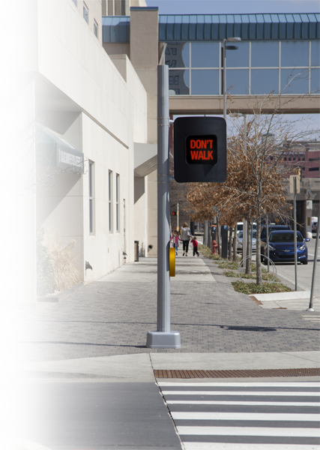
Pedestrian Signals & Timing
  Pedestrian signals have three intervals:
  Change interval – Orange flashing DON’T WALK or symbol of a flashing hand is used when pedestrians are not supposed to begin a crossing because there is not enough time left.

Slide 29
Pedestrian Signals & Timing
  Pedestrian signals have three intervals:
  DON’T WALK interval – Steady orange DON’T WALK or symbol of a hand is used when pedestrians are not supposed to be in crosswalk.

Slide 30
Features of
APS
Features of
APS

Slide 31
Criteria for WALK Indications
  The WALK indication provides critical safety information. The WALK indication should be:
  Readily detectable in the presence of ambient vehicular sound
  Highly localizable
  Uniquely recognizable as a WALK signal
  Unambiguous with regard to which crosswalk has the WALK interval

Slide 32
Criteria for WALK Indications
  In the U.S., the MUTCD and Draft PROWAG currently provide some specific criteria for WALK interval indications:
  Shall have audible and vibrotactile indications of the WALK interval. Audible indication shall be tone or speech message. (Draft PROWAG)
  The information provided “…shall clearly indicate which pedestrian crossing is served by each device.” (MUTCD)
  The audible tone(s) shall be audible from the beginning of the associated crosswalk. (MUTCD)

Slide 33
Criteria for WALK Indications
  In the U.S., the MUTCD and Draft PROWAG currently provide some specific criteria for WALK interval indications:
  Volume shall be 2 minimum and 5 db maximum above ambient noise level in standard operation (Draft PROWAG & MUTCD)
  Should be no louder than the associated pushbutton locator tone unless a louder audible beaconing feature is actuated (MUTCD & Draft PROWAG which allows beaconing to exceed volume limits)

Slide 34
Criteria for WALK Indications
  In the U.S., the MUTCD and Draft PROWAG currently provide some specific criteria for WALK interval indications:
  If the tone for the WALK interval is similar to the pushbutton locator tone, the WALK interval tone shall have a faster repetition rate than the associated pushbutton locator tone. (MUTCD)

Slide 35
Current Recommendations for WALK Indications
  Audible and Vibrotactile Indications required:
  Audible (speech or tone) and vibrotactile indications of the WALK interval are required by Draft PROWAG.
  The MUTCD does not currently provide specifications of audible WALK indications except cautions about the use of tones that could be confused with birds or backup beepers.

Slide 36
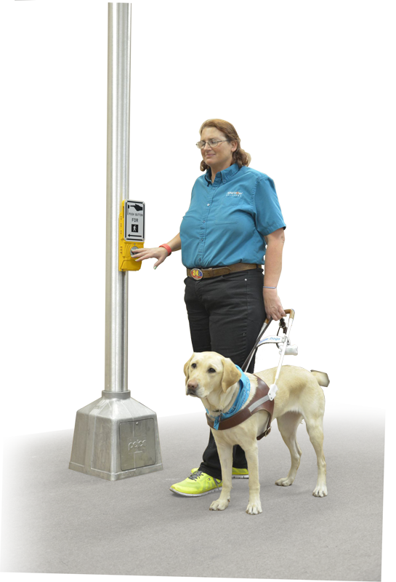
Current Recommendations for WALK Indications
  WALK indications can be
  provided by use of:
  Tones
  Speech Messages
  (aka Verbal Messages),
  and/or
  Vibrating Surfaces

Slide 37
Pushbutton Locator Tone
  A pushbutton locator tone is “A repeating sound that informs approaching pedestrians that they are required to push a button to actuate pedestrian timing and that enable pedestrians who have visual disabilities to locate the pushbutton.”
  The pushbutton locator tone is referred to by different names, including:
  Pole Locator
  Locating Tone
  Locator Signal
  Locator Audible
  Locator Tone

Slide 38

Pushbutton Locator Tone
  Draft PROWAG states that the volume of the pushbutton locator tone is to be adjusted to between 2 dB and 5 dB above ambient sound levels in standard operation.
  Pole Locator
  Locating Tone
  Locator Signal
  Locator Audible
  Locator Tone

Slide 39
Tactile Arrow
  A raised (tactile) arrow is used to communicate to pedestrians which crosswalk is controlled by the pushbutton.
  It is vitally important that the arrow points in the direction of travel on the crosswalk, as it indicates which crosswalk is controlled by that pushbutton.
  Misalignment of the arrow may direct a blind pedestrian into the center of the intersection.

Slide 40
Automatic Volume Adjustment
  Automatic volume adjustment is a term for volume control that is automatically responsive to ambient (background) sound.
  A louder signal is produced when vehicle and other noise volume at an intersection is high.
  A quieter sound is produced when background noise is lower.
  A microphone continuously samples the noise level and varies the volume in response to the existing sound levels.

Slide 41
Actuation Indicator
  An actuation indicator is a light, a tone, a voice message, or a combination of audible and visual indicators that informs pedestrians that the button has been pressed and that their desire to cross has been communicated to the controller.

Slide 42
Extended Button Press
  Extended button press is an option that actuates additional accessibility features. To activate the features, the pushbutton must be pushed and held for more than one second.
  Other names for this feature include:
  BAT – Button Actuated Timer
  Extended Push

Slide 43
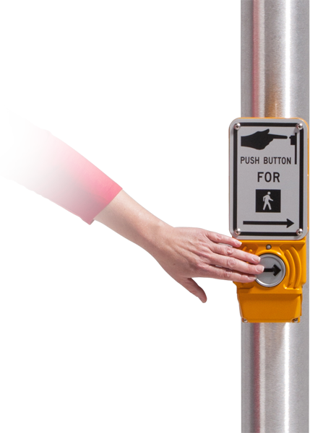
Extended Button Press
  Possible feature called by the extended button press include:
  Pushbutton Information Message
  Audible Beaconing
  Extended Crossing Time

Slide 44
Pushbutton Information Message
  A pushbutton information message is a recorded message that provides the name of the street and intersection with which that pushbutton is associated. It can also provide other information about the intersection signalization or geometry.
  This feature is referred to by different names including:
  Additional Message
  Instructional/
  Location Message
  Voice on Location
  Informational Message
  Verbal Message

Slide 45
Audible Beaconing
Audible beaconing is the use of an
audible signal in such a way that
blind pedestrians can hone in on
the signal coming from the target
corner as they cross the street.
MUTCD and Draft PROWAG recommendations are that the beaconing be called up by special actuation, rather than the APS functioning in the louder mode all the time.
  The recommended form of special actuation is an extended button press.

Slide 46
Alert Tone
An alert tone is a very brief burst of high frequency sound at the beginning of the audible WALK indication, which rapidly decays to the frequency of the WALK tone.
  It is intended to alert pedestrians to the beginning of the WALK interval.
  An alert tone may be useful if the WALK tone is not easily audible in some traffic conditions.

Slide 47
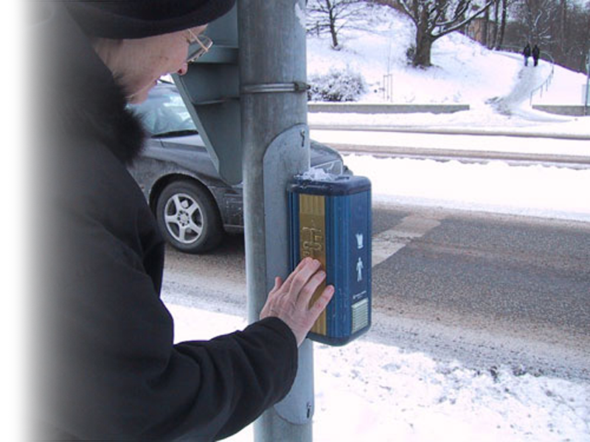
Tactile Map
A raised schematic map showing what will be encountered as the pedestrian negotiates the crosswalk controlled by that pushbutton.

Slide 48
Where Are APS Requirements?
The ADA requirements for state and local governments extend and increase the requirements in the Rehabilitation Act, requiring newly constructed or altered public facilities to be accessible, regardless of the funding source.
While the ADA does not require going back and reconstructing all intersections and locations, it does require improving accessibility when work is performed at a location.

Slide 49
MUTCD Recommends:
The installation of accessible pedestrian signals at signalized locations should be based on an engineering study, which should consider the following factors:
  Potential demand for accessible pedestrian signals
  A request for accessible pedestrian signals
  Traffic volumes during times when pedestrians might be present, including periods of low traffic volumes or high turn-on-red volumes
  The complexity of traffic signal phasing
  The complexity of traffic intersection geometry

Slide 50
APS Prioritization Tool

Slide 51
Designing APS Installations
Designing APS Installations

Slide 52
General Principles in Deciding on Location
Provide pedestrians signal information to those who cannot see the pedestrian signal head across the street.
Provide information to pedestrians about the presence and location of pushbuttons and if pressing a button is required to actuate pedestrian timing.
Provide unambiguous information about the WALK indication and which crossing is being signaled.

Slide 53
General Principles in Deciding on Location
Use audible beaconing only when necessary:
  Put as little additional sound in the environment as possible
  Avoid disturbance of neighbors
  Allow pedestrians who are blind or visually impaired to hear the traffic sounds as well as the APS

Slide 54
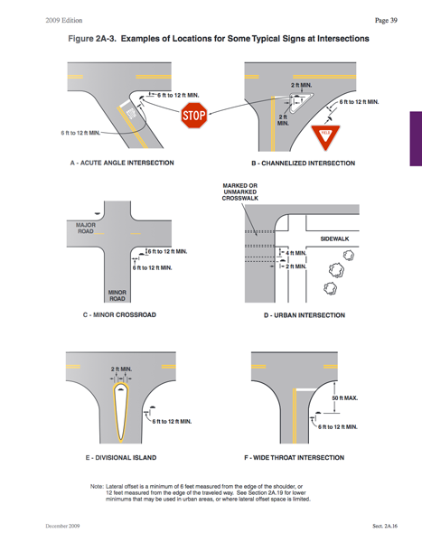
Optimal APS Location
Whenever possible, two poles should be installed for APS speakers to be located close to pedestrian departure location
and crosswalk.
Between the edge of the crosswalk line farthest from center
of the intersection
and the side of the curb ramp.

Slide 55
Optimal APS Location
Should be between 1.5 feet and 6 feet from the edge of the curb, shoulder or pavement but no further than 10 feet from the edge of the curb, shoulder or pavement.

Slide 56
Optimal APS Location
Whenever possible, two poles should be installed for APS speakers to be located close to the pedestrian departure location and crosswalk.
Between the edge of the crosswalk line farthest from center of the intersection and the side of the curb ramp.
Should be between 1.5 feet and 6 feet from the edge of the curb, shoulder or pavement but no further than 10 feet from the edge of the curb, shoulder or pavement.

Slide 57
APS Characteristics
The Draft PROWAG requires APS with the following features in new construction and reconstruction where pedestrian signals
are installed:
  APS devices integral with the pushbutton
  Audible and vibrotactile indications of the WALK interval
  WALK indication by tone or speech message
  Pushbutton locator tone wherever there is a pedestrian pushbutton

Slide 58
APS Characteristics
The Draft PROWAG requires APS with the following features in new construction and reconstruction where pedestrian signals
are installed:
  Pushbutton that is a minimum of 0.5 cm (2 in.) across in one direction and that contrasts visually with its housing or mounting
  Tactile arrow indicating the direction of travel on the crosswalk
  Braille or verbal information about name of the street

Slide 59
Recommended Features of an APS
Rapid tick WALK indication, no more than 2-5 dBA above ambient sound
Vibrotactile WALK indication
Speaker and vibrotactile indication located at pushbutton
Pushbutton locator tone
Tactile arrow on each device aligned in direction of travel on the crosswalk
Braille or audible street name

Slide 60
Reference/Sources
APSGUIDE.org/APS Workshop
Manual on Uniform Traffic Control Devices (MUTCD)
Proposed Accessibility Guidelines for Pedstrian Facilities in the Public Right-of-Way (Proposed PROWAG)
Transportation Association of Canada (TAC) – “The New TAC Accessible Pedestrian Signal Guidelines”

Slide 61
Reference/Sources
New York City’s DOT’s “Accessible Pedestrian Signals Program Status Report”
National Cooperative Highway Research Program – “Accessible Pedestrian Signals: A Guide to Best Practices”

